Slide 1

Designing a Machine Learning Model to Predict Defaulters
A Case Study Using Bajaj FinServ Dataset
Pulani Jayasena
Cohort 33
10/10/2024
Notes:
I'm going to present my capstone project, where I developed a machine learning model to help lenders make informed decisions by predicting potential loan defaulters.

Slide 2
Content
Introduction to the problem
Objective
Data Information
Data Preprocessing/ Feature Engineering
Feature Engineered Data
Initial Data Analysis
Exploratory Data Analysis
Train-Test Split
Model Building
Result Interpretation
Balancing
Result Interpretation-After Balancing
Confusion Matrix
Conclusion
Challenges and Solutions
Model Evaluation
Recommendations

Slide 3
Introduction to the Problem
Accurately assessing the creditworthiness of borrowers is essential
Reduces Risk of Defaults
Maintains Profitability
Prevents Non-Performing Assets (NPAs)
Regulatory Compliance
Sets Appropriate Interest Rates
Builds Sustainable Portfolio
Preserves Capital and Liquidity
Notes:
Assessing creditworthiness is useful, because it helps to
reduce financial risk, prevent loan defaults, and ensure long-term stability by helping lenders make informed decisions.

Slide 4

Objective
Develop a machine learning model to predict defaulters and non-defaulters based on financial and demographic data.

Slide 5
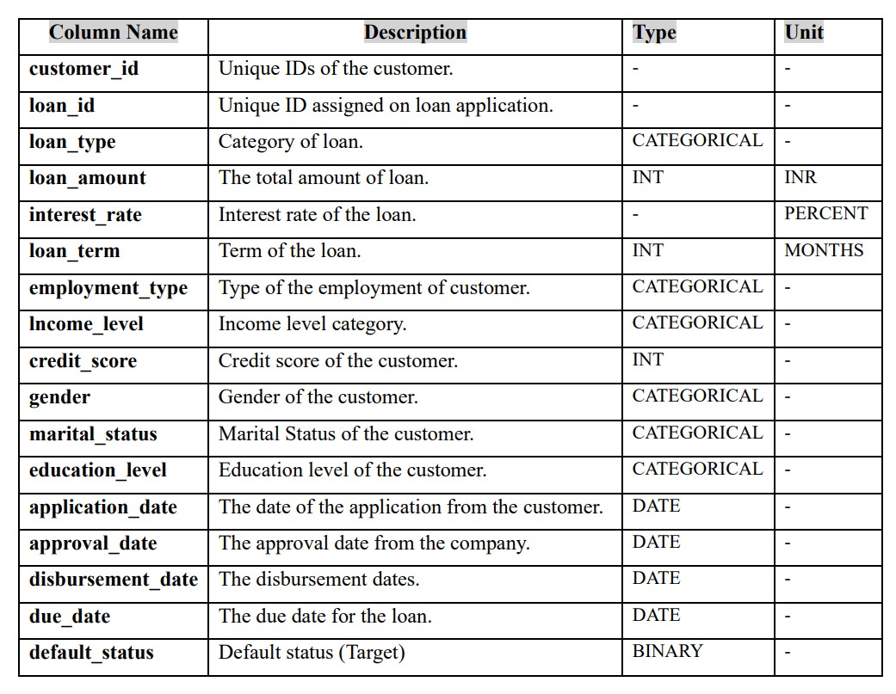
Data Information
Data Dictionary
Notes:
The data consists of both financial and demographic information, These features are essential for predicting defaulters and non-defaulters. Understanding the nature of the data, including categorical and numerical columns, helped guide the preprocessing steps.

Slide 6
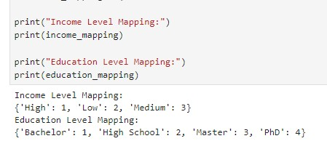
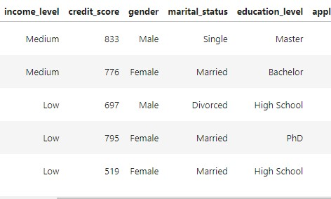
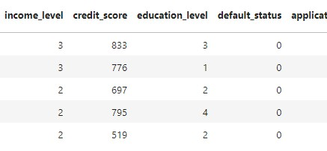
Data Preprocessing/ Feature Engineering
Data cleaning
Check for missing, null and duplicate value
Convert categorical data to numerical
Encoding
Label encoding – “educational_level” & “income_level” column
one-hot encoding – “gender”, “loan-type”, “employment_type”,
Label Encoding with Defined Hierarchy
Notes:
Label encoding has done for when the categorical variable has an inherent order, in this case I have defined that hierarchy starting from 1 instead of 0. Other categorical columns which don’t have order went under one-hot encoding process.

Slide 7
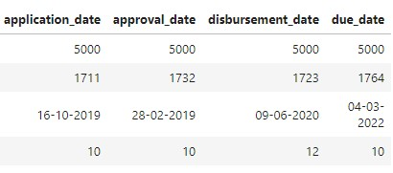
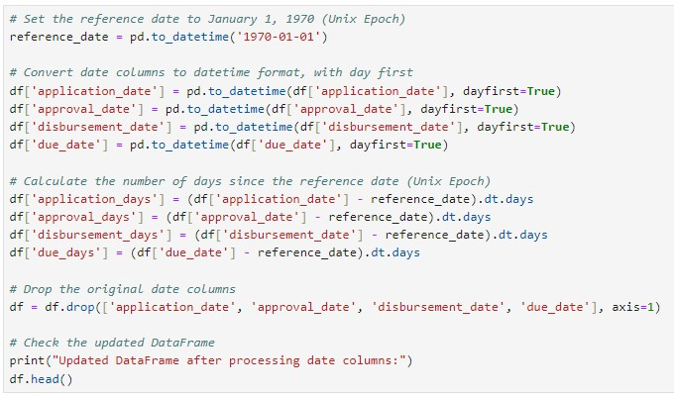
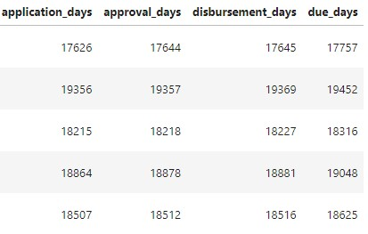
Data Preprocessing/ Feature Engineering
Transforming the date columns
Date transformation
Drop irrelevant columns
“customer-id”, “loan_id”, original date columns
Balancing data set as it was highly imbalanced
SMOTE, Random under sampling, Random over sampling
Notes:
As date columns was in date format, I have transferred them into numerical column, which shows total number of days from the reference date Unix epoch

Slide 8
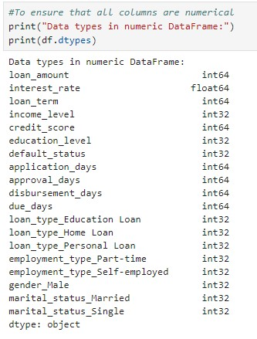
Feature Engineered Data
All the data has been converted to numerical value

Slide 9
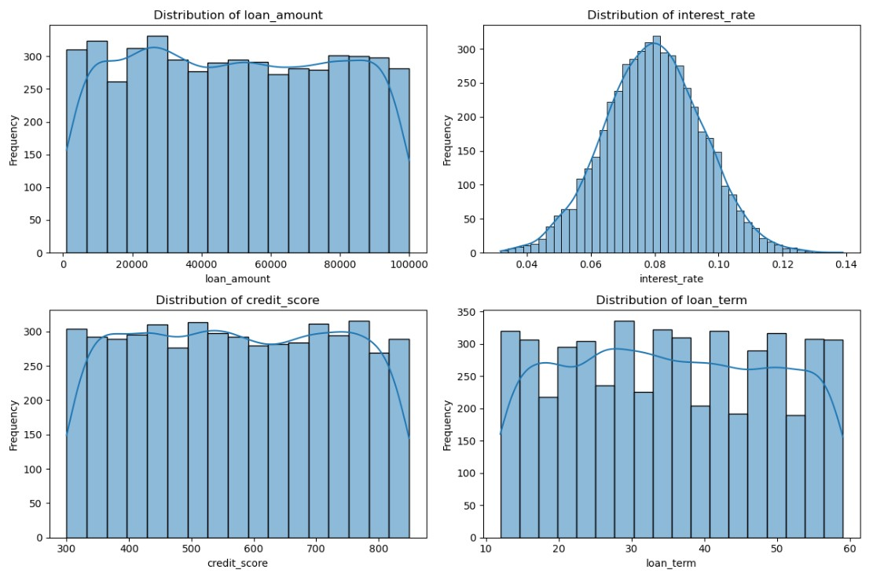
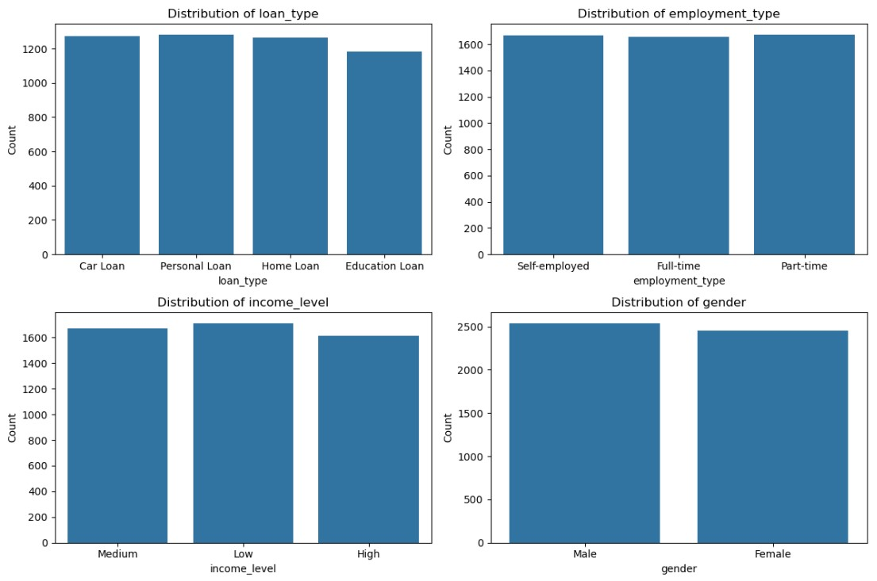
Initial Data Analysis
Distribution Analysis
Distribution of numerical columns
Distribution of categorical columns
Notes:
As first step did distribution analysis
Loan amount, credit score, loan term is relatively uniform across the range, Interest Rate has a roughly bell-shaped distribution, which suggests that most loans are issued at around 7-8% interest rates. The dataset appears balanced across most of the categorical features,

Slide 10
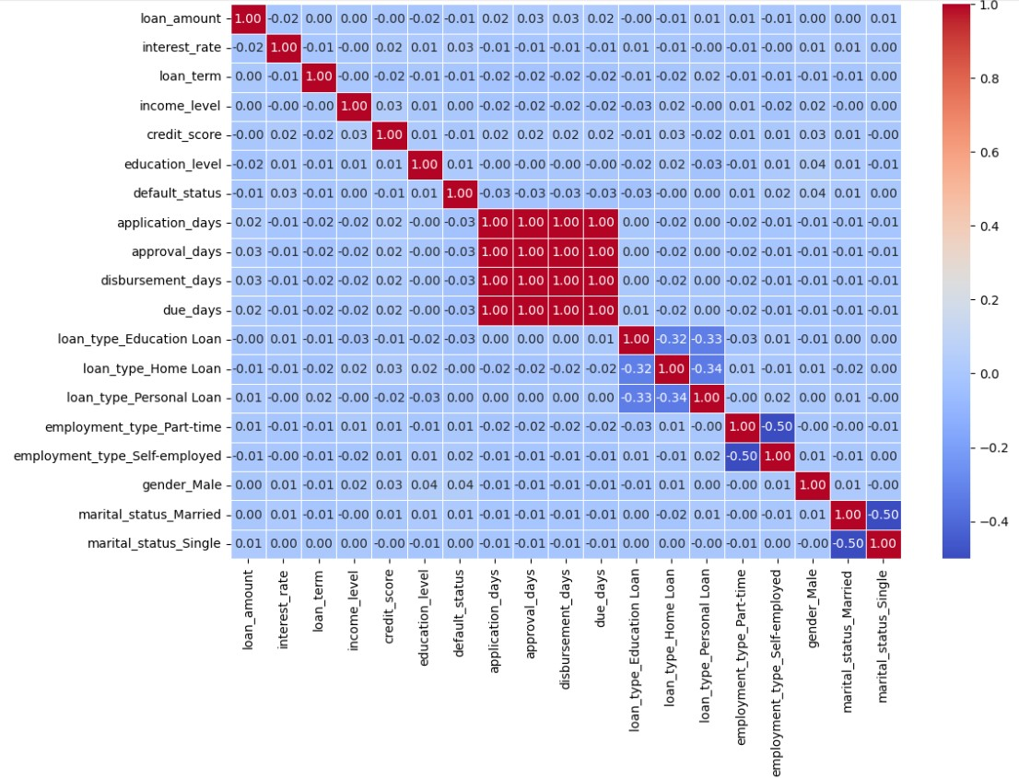
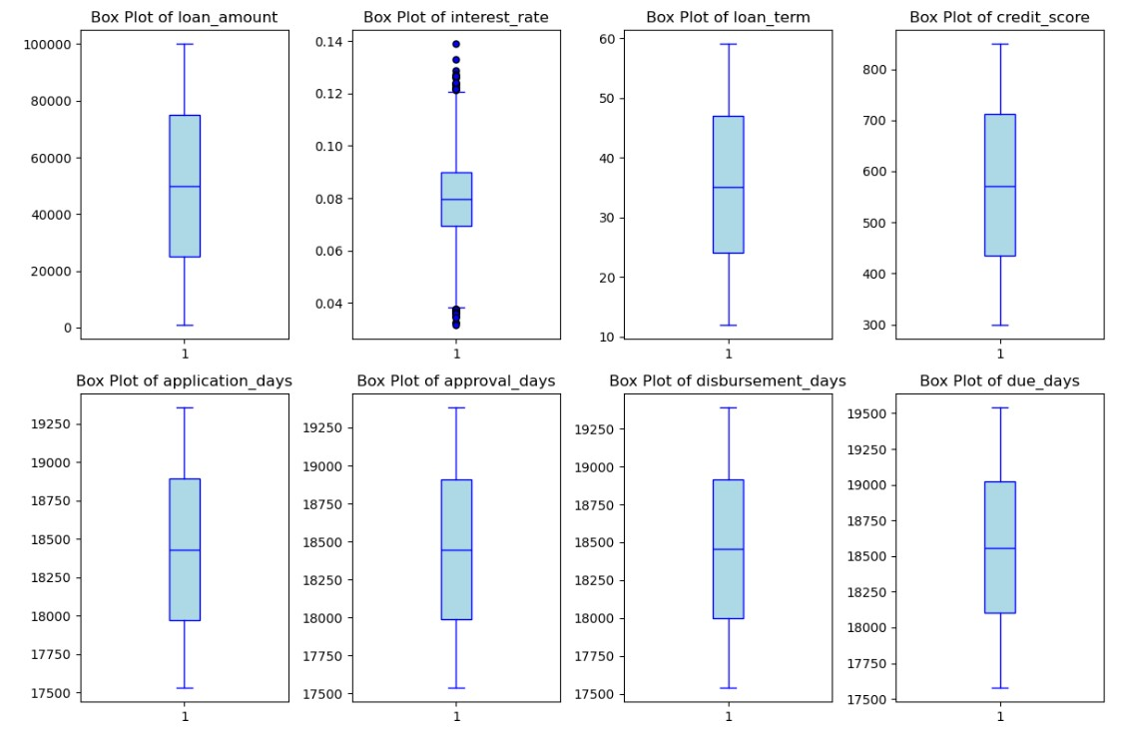
Exploratory Data Analysis
Box Plots
T-Test
Interest rate, application dates
Chi-Square Test
Loan type, Gender
Key predictors
Correlation heat map
Notes:
Form the correlation heat map, observed that
Default_status does not have high linear correlations with other variables Form the box plots we can see Interest_rate column, shows a high number of outliers Interest rate, application dates, Loan type, and Gender have identified as key predictors from T-test and Chi-square test

Slide 11
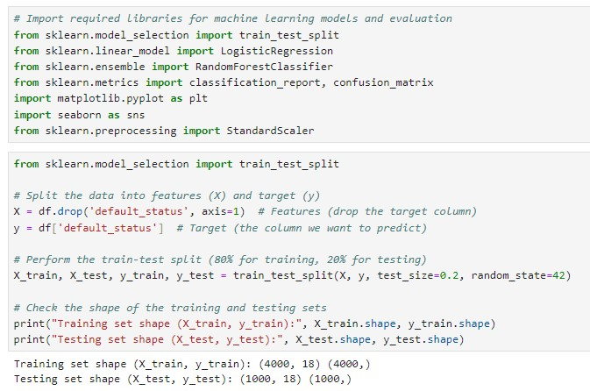
Train-Test Split
80/20 has been selected, Why?
Larger training set- beneficial for imbalanced data set
Helping to reduce bias towards majority class
Higher model stability
Adequate test data
Notes:
this process is essential for building reliable machine learning models
I used an 80-20 train-test split due to the dataset is imbalance, with more non-defaulters.
A larger training set helped the model learn better from the minority class (defaulters), reducing bias and improving generalization, while still ensuring sufficient testing data for evaluation.

Slide 12
Model Building
Selected Models – Why ?
Logistic Regression
Effective model for binary classification (defaulters/non-defaulters)
Less prone to overfitting
Random Forest
Handles large datasets with higher dimensions
Ensemble model that combines multiple Decision Trees
improve performance by reducing overfitting and increasing generalization.
XGBoost
Powerful gradient boosting algorithm known for its speed and performance
Mitigates overfitting by boosting multiple trees
Scales better and tunes easily for high performance, especially when dealing with imbalanced classes
Notes:
I have selected 3 models,
I didn’t select SVM due to its high computational cost and sensitivity to imbalanced data. Decision Tree was avoided for its tendency to overfit and lower accuracy compared to ensemble methods like Random Forest and XGBoost.

Slide 13
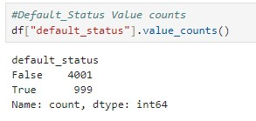
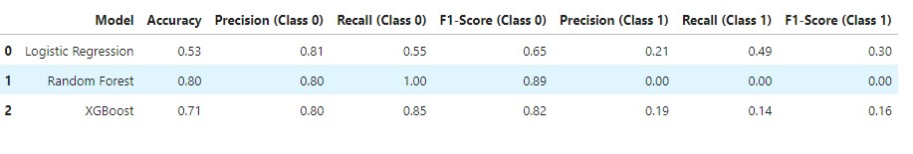
Result Interpretation
Original Data Set
Results
Conclusion
Logistic Regression is the most balanced model but overall low performance for Class 1.
Random Forest performs very well for non-defaulters, but completely fails to identify defaulters (Class 1).
XGBoost Offers a better balance than Random Forest, though its performance on defaulters is still weak.
Notes:
class distribution of Original data set - non-defaulters 4001, defaulters 999
Form the results we can observe that Logistic Regression had low accuracy for defaulters, while Random Forest couldn’t catch or predict any defaulters. It’s very critical in this case.. XGBoost performed better but still had weaknesses in predicting defaulters.
So we have to balance the data set in next step

Slide 14
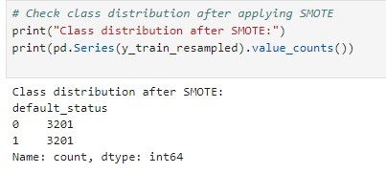
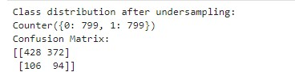
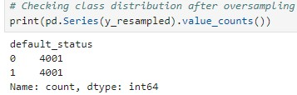
Balancing
SMOTE
Random Under Sampling
Random Over Sampling
Class distribution after SMOTE
Class distribution after Random Under Sampling
Class distribution after Random over sampling
Notes:
Therefore I have applied 3 balancing techniques.

Slide 15
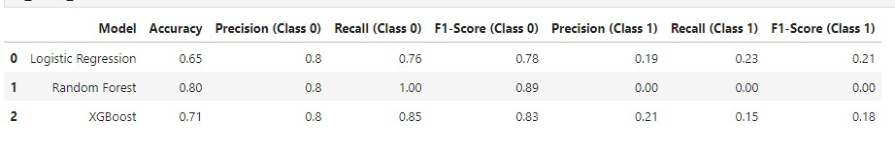
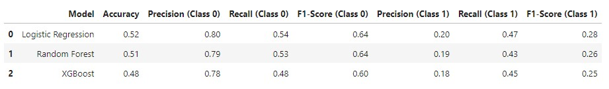
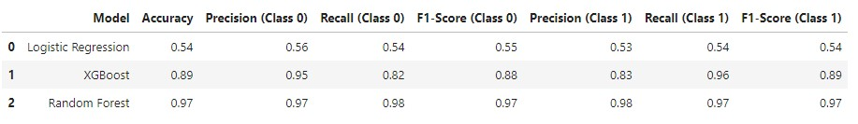
Result Interpretation- After Balancing
SMOTE (3021,3201)
Random Forest: High accuracy, poor for defaulters.
Logistic Regression: Balanced, needs improvement.
XGBoost: Better for defaulters, overall weak.
Random Under Sampling (799,799)
Logistic Regression: Best overall balance, excels with non-defaulters.
Random Forest: Slightly better for defaulters, close overall performance.
Random Over Sampling (4001,4001)
Logistic Regression: Low accuracy (0.54), struggled with defaulters.
XGBoost: Good accuracy (0.89), strong for defaulters.
Random Forest: Best accuracy (0.97), near-perfect precision and recall for both classes.
Notes:
We can see, After Both smote, and RUS all three models are struggling with defaulters.
In this case, having better score for precision and recall for defaulters is essential
After Random Over –Sampling II have obtained 97% of accuracy for the random forest and 89% accuracy for the XG Boost.
In the random forest precision for defaulters are 98% and recall for defaulters 97%.
Logostic regression also obtained 54% of accuracy.

Slide 16
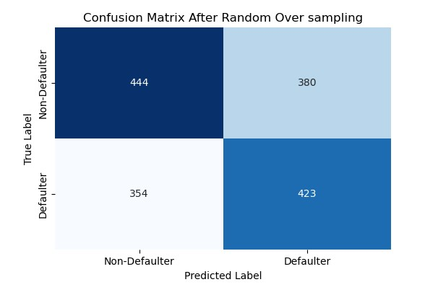
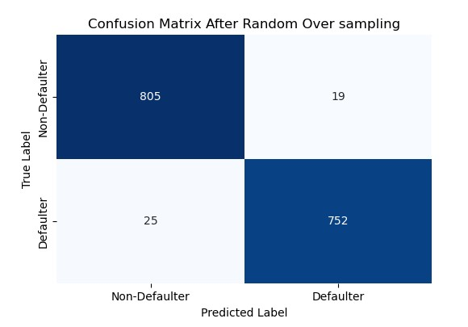
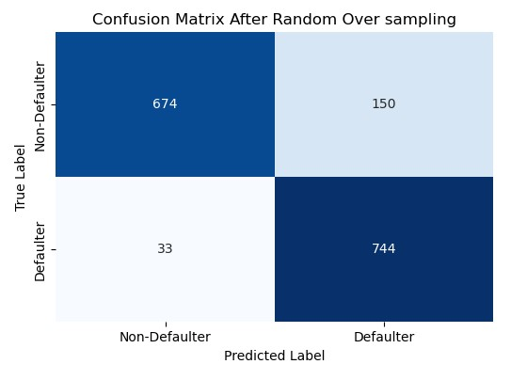
Confusion matrix – Random Over Sampling
Logistic regression, scaling, ROS
Random Forest
XGBoost
Notes:
Random Forest (center), achieves near-perfect results, with only 19 misclassifications of non-defaulters and 25 misclassifications of defaulters, indicating its robustness in handling imbalanced datasets after oversampling.

Slide 17
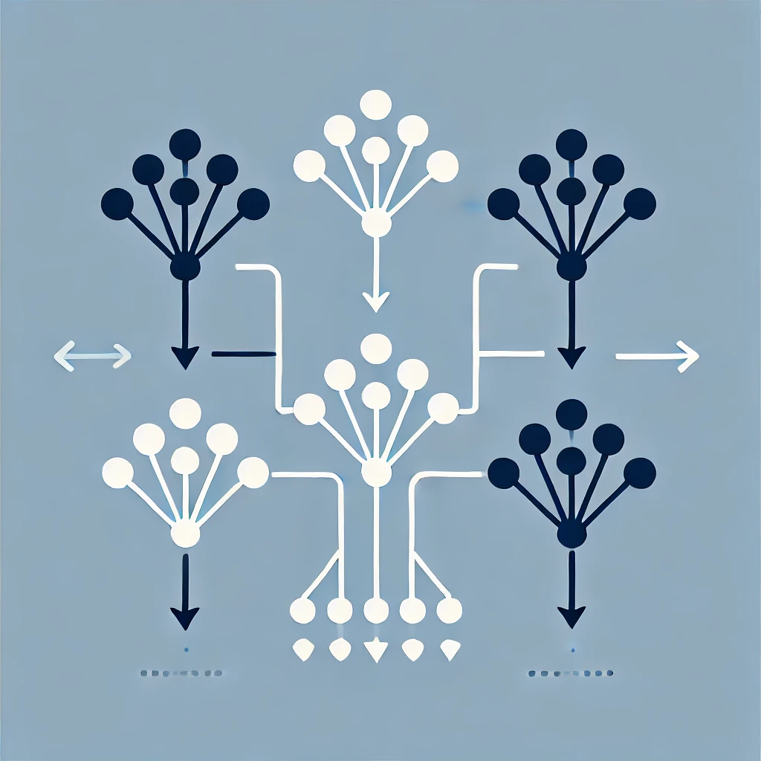
Conclusion
Random Forest and XGBoost are
tree-based models
can handle non-linear relationships and imbalanced data better,
which explains their superior performance.
Random Forest is likely the optimal choice with 97% of accuracy based on its exceptional performance,
with XGBoost also being a strong alternative with 89% of accuracy

Slide 18
Challenges and Solutions
Challenge | Solution
Data imbalance made it hard to predict defaulters. | Used SMOTE, RUS, ROS to balance the dataset.
Hard to achieve high precision and recall for defaulters. | Fine-tuned hyperparameters and adjusted class weights.
Handling date columns for prediction was challenging. | Transformed date columns into numerical features.
Handling label encoding was challenging | Defined label encoded hierarchy which starts from 1 instead of 0
Difficult to identify key predictive features. | Performed EDA and tried different models and tried feature selection techniques.
Correlation heat map showed no significant relationships. | Conducted T-tests and Chi-Square tests for deeper insights.

Slide 19
Model Evaluation
Cross-Validation
Use k-fold cross-validation to ensure model generalization across different data subsets.
Train-Test Split
Stratify your train-test split to simulate model performance on unseen data.
Validation on New Dataset
Test the model on a new dataset from the same domain to check for overfitting.
Data Drift Monitoring
Compare feature distributions between training and new datasets to detect data drift.
Feature Generalization
Ensure key features like credit score and income generalize well across datasets.
Model Performance
Measure accuracy, precision, recall, and F1-score on both the original and new datasets.
Hyperparameter Tuning
Re-tune hyperparameters if performance varies on new datasets to improve adaptability.
Notes:
We can improve evaluation by using cross-validation, stratified train-test splits, validating on new data, monitoring data drift, and tuning hyperparameters for better performance and generalization.

Slide 20
Recommendations
Precision & Recall
Optimize recall to catch more defaulters, adjust decision thresholds for balance.
Model Validation
Use k-fold cross-validation to ensure model stability and prevent overfitting.
Feature Importance
Highlight key features like interest rate and credit score for better decision-making.
Interpretability
Use SHAP and feature importance plots to make complex models easier to understand.
Hyperparameter Tuning
Further tune XGBoost and Random Forest to improve performance.
Class Imbalance
Continue using SMOTE, class weights, and ensemble methods to address imbalance.
Business Application
Regularly retrain and evaluate the model in production with real-world data.
Economic Context
Monitor model performance over time, considering economic factors.
Feature Engineering
Enrich the dataset and revisit date columns to capture important patterns.
Notes:
I recommend optimizing recall, using cross-validation, highlighting key features, enhancing interpretability, tuning hyperparameters, addressing class imbalance, retraining regularly, monitoring economic factors, and refining features.

Slide 21

Questions?
Thank You!

